Slide 1
Low Level Design (LLD)
Part 2

Slide 2
Constructors
Unlike normal member functions, constructors have specific rules for how they must be named:
Constructors must have the same name as the class (with the same capitalization).
Constructors have no return type (not even void).

Slide 3





Destructors
Classes have another type of special member function that is called automatically when an object is destroyed. This function is called a destructor.
Destructors are designed to allow a class to do any necessary clean up before an object of the class is destroyed.
Like constructors, destructors have specific naming rules:
The destructor must have the same name as the class, preceded by a tilde (~).
The destructor can not take arguments.
The destructor has no return type.

Slide 4


Example
class A { public: A(int a) : a_(a) {} ~A() {} private: int a_: };
Constructor
Destructor

Slide 5

Constructor member initializer lists
Let’s go to VS Code!

Slide 6
Constructor member initializer lists
To have a constructor initialize members, we do so using a member initializer list (often called a “member initialization list”).
The members in a member initializer list are always initialized in the order in which they are defined inside the class (not in the order they are defined in the member initializer list).
The bodies of constructors functions are most often left empty. However, because the statements in the body of the constructor execute after the member initializer list has executed, we can add statements to do any other setup tasks required.

Slide 7
Let’s come back to Inheritance!
.

Slide 8
Inheritance
class Employee : public Person {
public: string job_role;
string company;
int salary; int id;
};
class Person {
public: int age; string name; string address;
string mobile_no; string aadhaar_no;
};
class SoftwareEngineer : public Employee {
public: string team; string tech_stack; string language_expertise; int level;
};

Slide 9
Inheritance Terminology
class Person {
public: int age; string name; string address;
string mobile_no; string aadhaar_no;
};
Base Class
class Employee : public Person {
public: string job_role;
string company;
int salary; int id;
};
Derived Class

Slide 10
Construct Inherited Class
Let’s go to VS Code!

Slide 11
Construct / Destruct Inherited Class
Most base class is initialized first.
Most derived class is destructed first.

Slide 12
Inheritance and access specifiers
Public: can be accessed by anybody
Private: can only be accessed by class members
Protected: can be accessed by class members, and derived classes.

Slide 13


Different kinds of Inheritance
class A { public: a_public_;
private: a_private_;
protected: a_protected_; };
class B : public A { a_public_;
a_private_
a_protected_ };
int main() { B b;
b.a_public_;
b.a_private_;
b.a_protected_;
return 0; }

Slide 14



Different kinds of Inheritance
class A { public: a_public_;
private: a_private_;
protected: a_protected_; };
class B : private A { a_public_;
a_private_
a_protected_ };
int main() { B b;
b.a_public_;
b.a_private_;
b.a_protected_;
return 0; }

Slide 15
Different kinds of Inheritance
Accessible, but behave like a private members of class B
class A { public: a_public_;
private: a_private_;
protected: a_protected_; };
class B : private A { a_public_;
a_private_
a_protected_ };
int main() { B b;
b.a_public_;
b.a_private_;
b.a_protected_;
return 0; }

Slide 16
Different kinds of Inheritance
class A { public: a_public_;
private: a_private_;
protected: a_protected_; };
class B : protected A { a_public_;
a_private_
a_protected_ };
int main() { B b;
b.a_public_;
b.a_private_;
b.a_protected_;
return 0; }

Slide 17
Different kinds of Inheritance
Accessible, but behave like protected members of class B
class A { public: a_public_;
private: a_private_;
protected: a_protected_; };
class B : protected A { a_public_;
a_private_
a_protected_ };
int main() { B b;
b.a_public_;
b.a_private_;
b.a_protected_;
return 0; }

Slide 18
Most Practical Inheritance
Remember others only for theory purposes :P
class A { public: a_public_;
private: a_private_;
protected: a_protected_; };
class B : public A { a_public_;
a_private_
a_protected_ };
int main() { B b;
b.a_public_;
b.a_private_;
b.a_protected_;
return 0; }

Slide 19
Best practice to construct inherited classes
Base
From the constructor of Derived class, call the constructor of Base class.
The corresponding constructors will take care of initializing their class members.
Derived

Slide 20
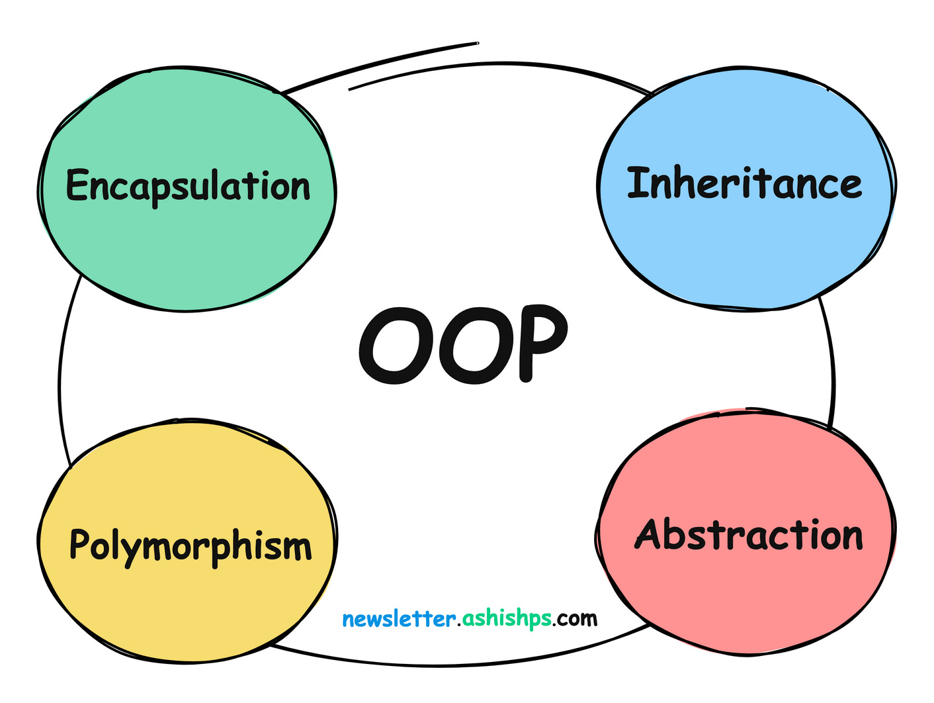

Slide 21
Polymorphism
The word “polymorphism” means having many forms. In simple words, we can define polymorphism as the ability of a message to be displayed in more than one form.

Slide 22
Polymorphism
Let’s go to VS Code!

Slide 23
What’s next?
Advance OOPs concepts
Polymorphism
Virtual Functions
Abstractions

Slide 24
Thank You!

